Slide 1
Podcasting, Blogging & YouTube Videos Pipelines to Building Fans Who Become Customers

Slide 2
What We Will Cover
What is Podcasting really and technically – radio & TV to phones
Monetizing Radio, TV Then vs Podcasting Now
The basics of how it works and how easy to setup with Wordpress
Audience building strategies – no listeners, no viewers, no money
Ways to make money and generate sales
Good microphone, recording software, production assets
The Killer iPhone apps - Bossjock Studio, iMovie, Switcher Go, YouTube Director & the Apogee & iRig mics
YouTube videos & repurposing as podcast, blogs, & Facebook

Slide 3
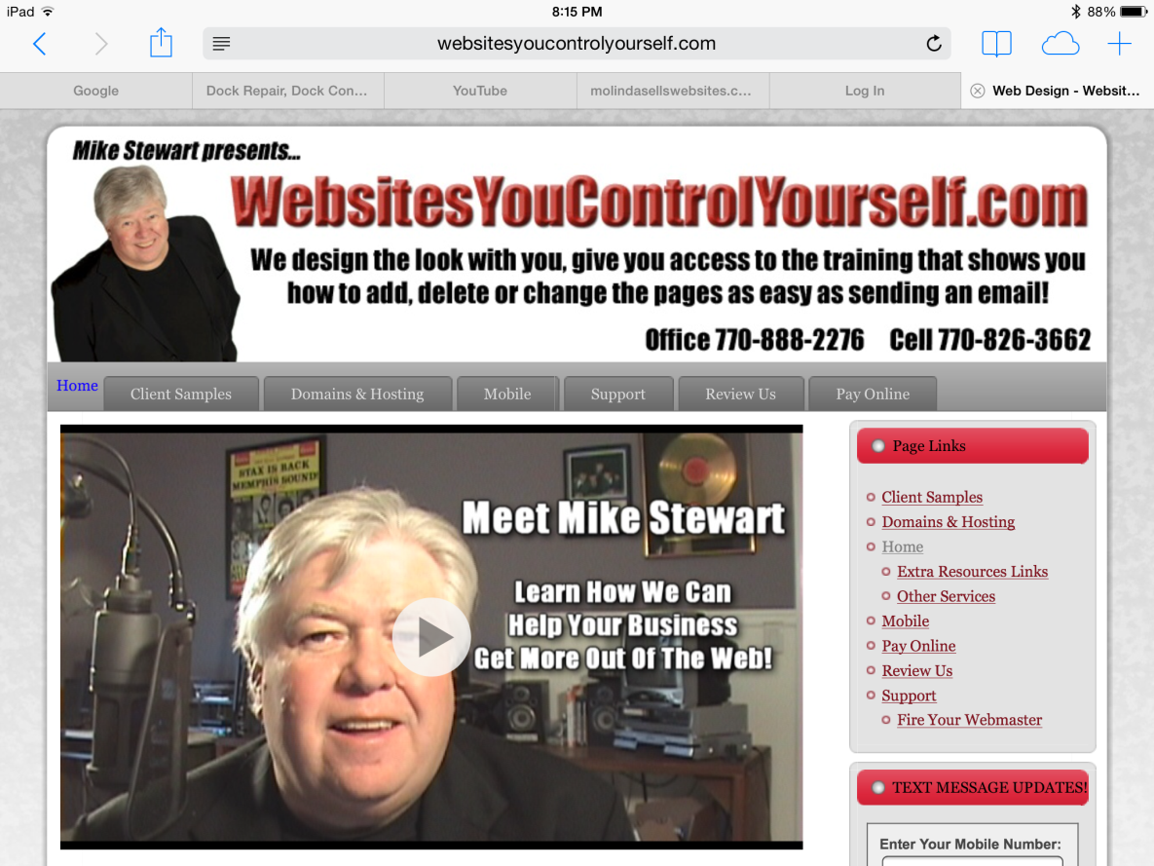
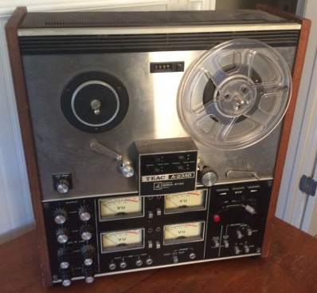
Why you should listen to me!
Over forty years experience in audio & video production!
Composed music for TV and radio since 1979 Got a gold record for PacMan Fever in 1982 Played keyboards on hundred's of records and jingles with every Atlanta celebrity Known world wide as the audio video guy Pioneered the video sales letter in 2004 Recorded the theme to Wreck It Ralph for Disney at home on my PC in 2012 over the internet Now work with business owners of all types to learn the power of video for the internet. All this experience lead me here to you today!
Working for Ted Turner 1980
My first tape recorder 1976

Slide 4
The Night I Met Ted Turner
“Total mobile subscriptions by 2020 will actually number 9.2 billion – not counting computers, smart TVs, Alexa’s, Apple TVs and WIFI enabled automobile dashboard devices
Ted was excited that night because the reach of TBS was 7 million subscribers

Slide 5
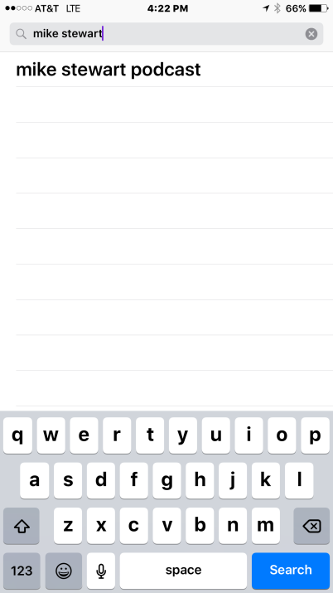
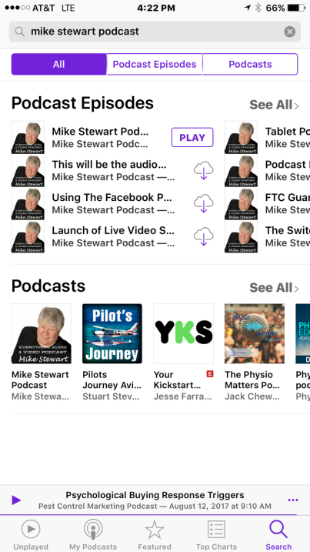
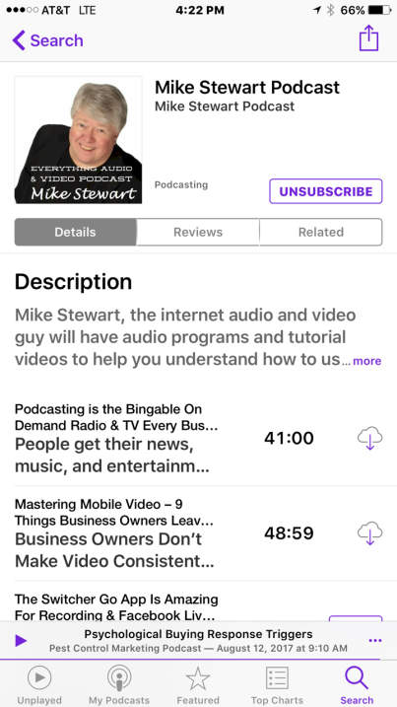
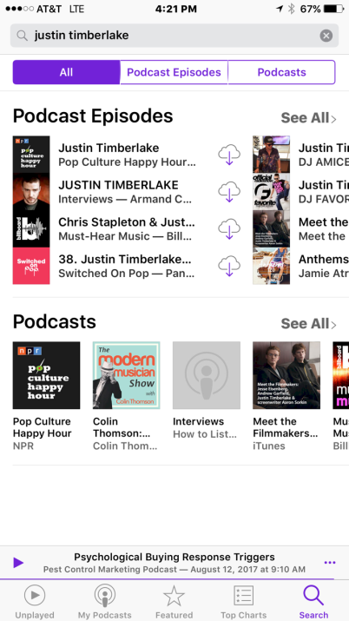
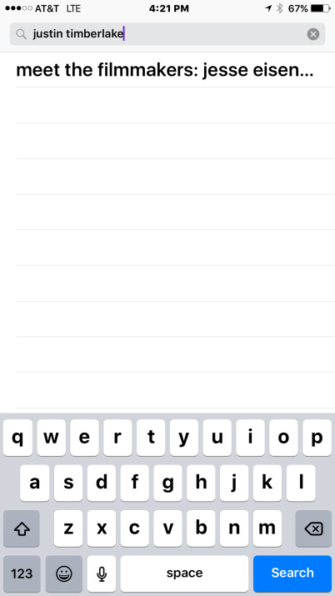
If 9 Billion Phones, Billions of Other Connections Are you found in iTunes or Stitcher?

Slide 6
What You Have Vs What Ted Had
Broadcasting content to the world in 1980 cost millions in equipment and content creation – today is basically free for effort
You have the internet and mobile devices to build your audience, he only had expensive satellite connections from Atlanta, trade shows and expensive sales teams/talent content producers
He couldn’t monetize a niche, you can. He needed millions of viewers to charge for advertising, all you need is super fans
You have a bigger reach, minimal expense, and opportunities if you build and promote. Ted spent a fortune building and promoting

Slide 7
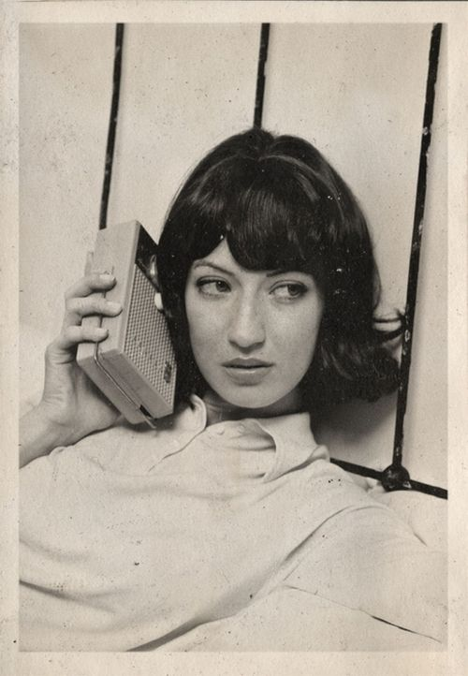
What is Podcasting Really?
Released January 2007
Exploded in the 50’s & 60’s
Since the invention of the transistor, the world demands portable content, only difference today is the phone is the transistor radio & TV, and the content must be on demand, not on a schedule set by the broadcaster

Slide 8
What is Podcasting Really?
Podcasting is the ability for any audio or video content creator to reach their audience or fans on the billions of devices now in place that can tune in that content on demand, subscribe and engage with that creator on a regular basis.
Technically, it is an internet subscription to bingable, on demand audio or video content. An mp3 audio file or an mp4 video file that any one can create for FREE can build an audience. The internet is the antenna, RSS is the transmitter

Slide 9
Monetizing Radio, TV Then vs Podcasting Now
A radio & TV station or network had to prove they had an audience of listeners and viewers. Arbitron and Neilson was their proof Otherwise the sales team could not sell ad space to make the broadcaster profits. Period
The same is true with a Podcasting, no listeners, no views, no money. But build a big audience, you could make money promoting things that you bring you profits. Your products or services, products that pay you commissions, and sponsors, even donations like KickStarter, or Patreon – the bigger the fan base, the bigger the profit potential

Slide 10
The basics of how it works and how easy to setup with Wordpress
Step 1. Get a domain name/title and setup a Wordpress site
Step 2. Get the PowerPress Plugin by BluBrry
Step 3. Create your Podcast square image logo iTunes suggests 3000 x 3000 pixel artwork
Step 4. Fill settings of Title, Description, Categories, Rating of your show and all settings of Powerpress
Step 5. Submit your show to iTunes, & Stitcher for approval
Step 6. Create great content and recommend things that make you money – be consistent and regular.. Radio & TV are 24/7

Slide 11
Audience Building Strategies
Radio & TV advertise to build an audience in a market, you should too if you have a budget using ads on Google, Facebook, YouTube.. If not.. Start building an email list, email every time you post a new show
Repurpose your YouTube videos in Wordpress, Facebook, Instagram, Linkedin Create an Facebook business page, and business group to share ideas with your fans, ask what they want to hear or see from you
Ask for subscribers every show, ask to share with their friends, entice them to engage and come back to listen next time

Slide 12
Ways to make money & generate sales
Products you create – books, ebooks, CDs, DVDs, subscription sites,
events online and offline, group coaching, one on one coaching, shipped products you resell, services you are a reseller or affiliate
Or just generate leads to come in or call your business

Slide 13
Good Mic, Recording Gear
Studio Large Diaphram Mic
Pop Filter
Scissor Boom
Shock Mount
Pro USB Computer Mixer
Headphones

Slide 14
Software & Production Assets
PC Software – Audacity (FREE), Audio Studio, Adobe Audition, Vegas, Adobe Premier, Filmora – 1000 others
Mac Software – Audacity (FREE), Garage Band, Wav Pad, iMovie, Final Cut, Adobe Premier, 1000 other
Camtasia & Skype for Internet Interviews, Zoom.us
Royalty Free Music – OnlineVideoLegalMusic.com
Jingles, Ads, Sweepers, Transitions, Sound Effects

Slide 15
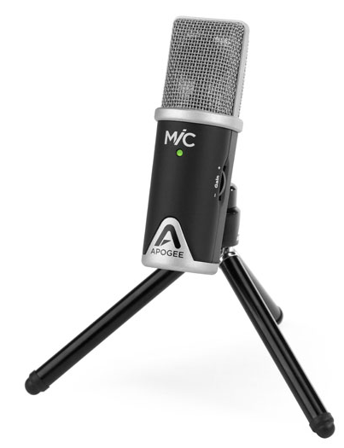
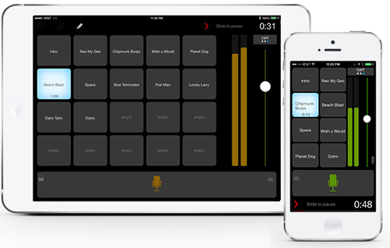
How the iPad apps are amazing! BossJockStudio & Apogee Studio Mic
Boss Jock App – iPad or iPhone Only
Apogee Mic plugs in iPhone or iPad

Slide 16
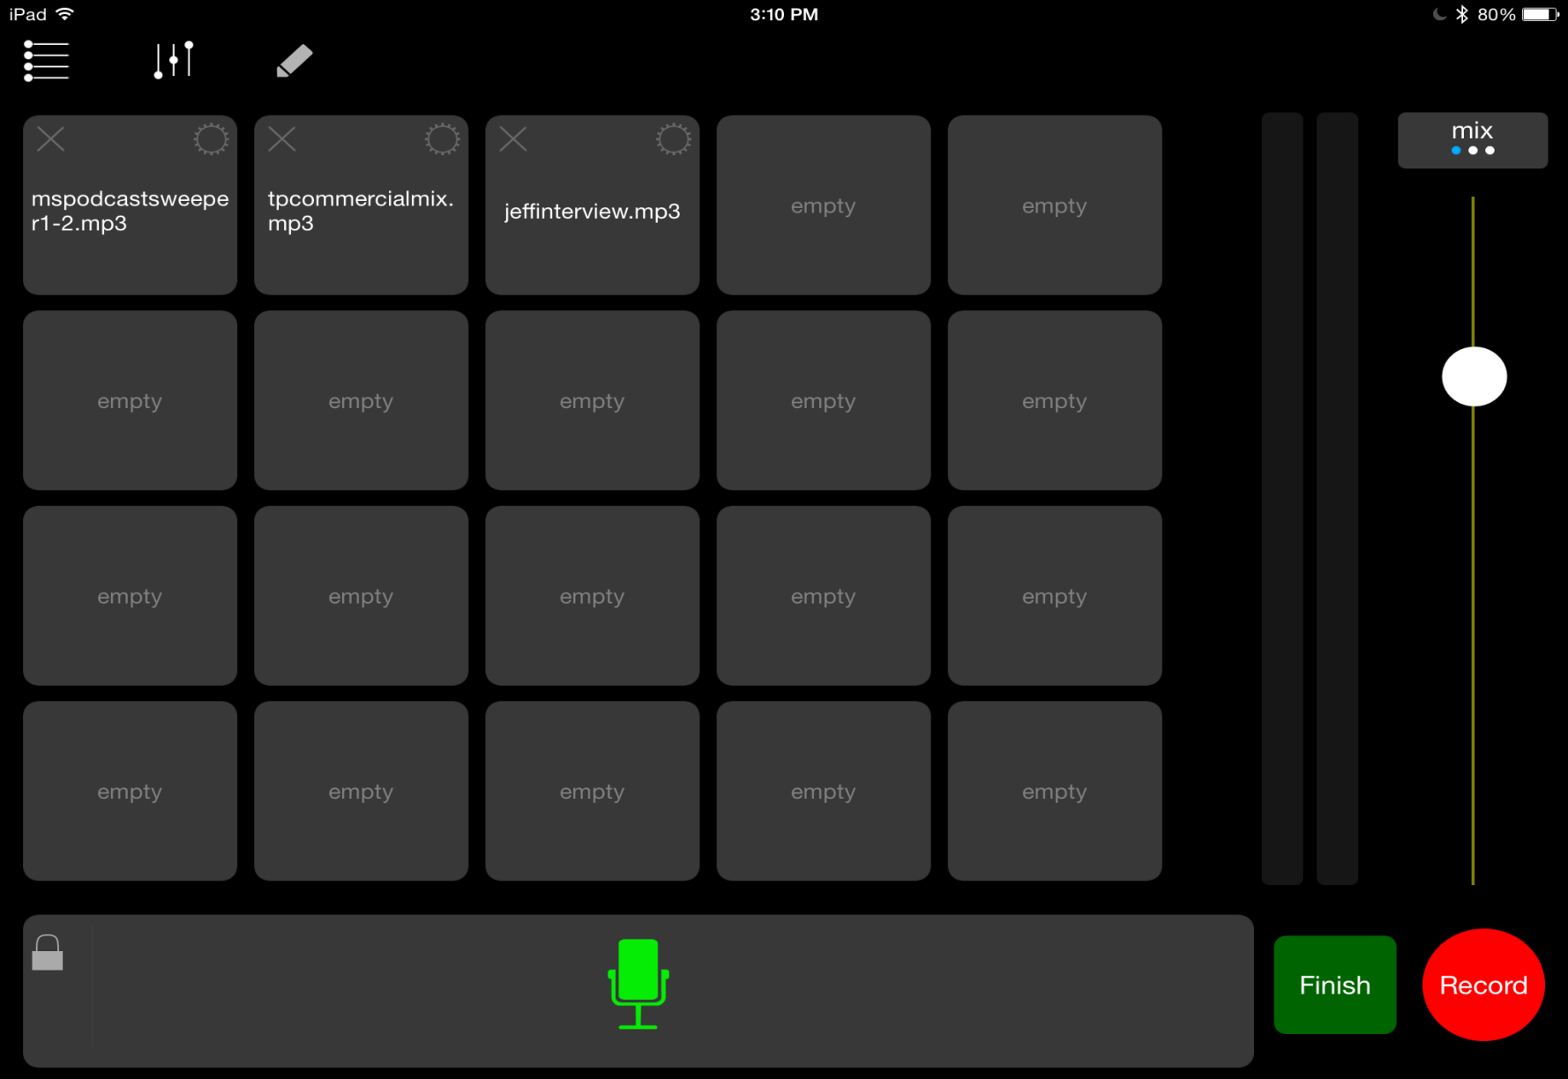
Boss Jock App is Easy and Fast
One touch start record
Mic on, off temporary or locked
Cart machine like in radio stations to cue pre-recorded sweepers, effects, interviews, sound effects or advertising promos – 10 minute show only takes 10 minutes to produce

Slide 17
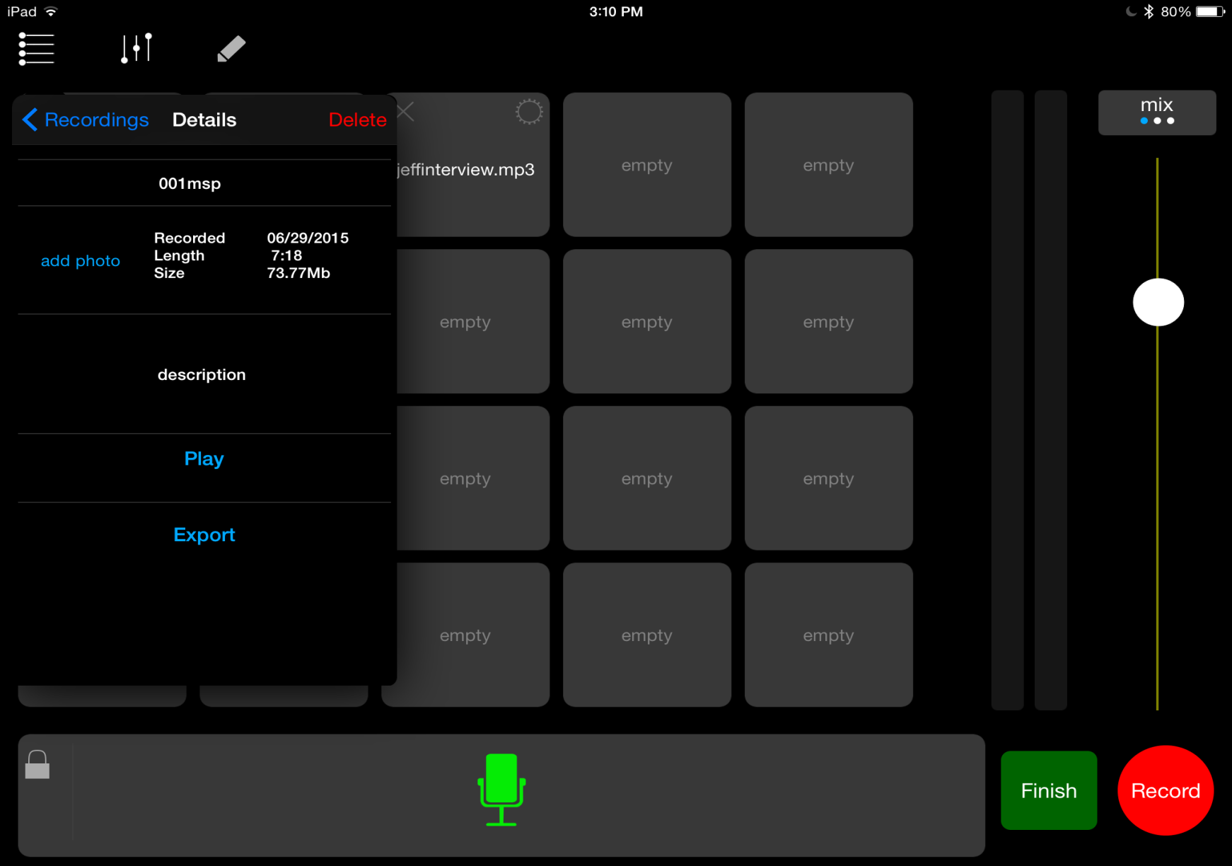
Options to send podcast audio to Wordpress
When show is done, you save and export to the internet with lots of easy options

Slide 18
Options to send podcast audio to Wordpress

Slide 19
LIVE DEMO OF BOSSJOCK

Slide 20
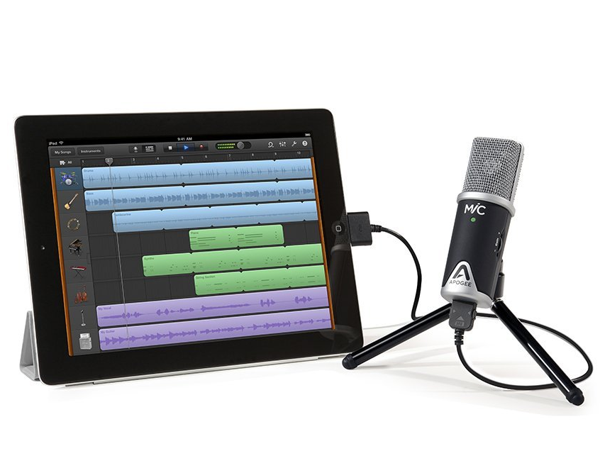
Mobile Devices Make HD Video
The camera in phones and tablets are better than camcorders of 10 years ago and are HD. The microphones are amazing!
Selfie sticks, external mics, mounts, lens and the apps are dirt cheap and enable you to create amazing video content to sell, share, and market your products & brands.

Slide 21
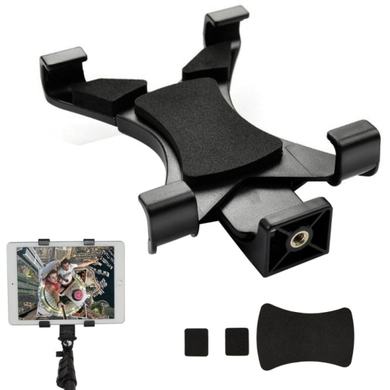
Phone and Tablet Mounts
Ipow Universal Mini Tripod
Selfie Stick Monopod
www.MikeSuggests.com/gear/

Slide 22
External Mics For Pro Audio Results
Apogee Lightning Mic - Apple Only
www.MikeSuggests.com/gear/

Slide 23
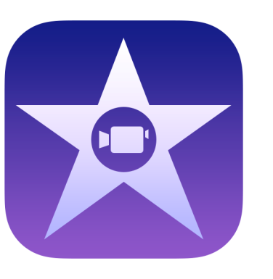
Easiest Video Creation Apps For YouTube Create content to repurpose on Podcasts & Facebook
YouTube Capture
YouTube Director
iMovie

Slide 25
BONUS: Amazing New Recording App Facebook & YouTube Live – iPhone Only
Switcher Go App

Slide 28
Now Easy & So Affordable
Coming Soon & Interesting Lesson
Power Director
Facebook

Slide 29
Steps to Build Fans
You must have an OPTIMIZED YouTube channel and post Podcastable videos regularly
Build a FB business page or group, go live with killer content –upload YouTube , repupurpose live videos as podcasts
With a Wordpress website, you can podcast audio or video repurposed from YouTube

Slide 30
So Who Is Killing It With Podcasting YouTube & Social Media Video? The Media Worth Being Social!

Slide 32
Title
What is Podcasting really.

Slide 34
Title
What is Podcasting really.

Slide 35
Recap Of Your Takeaways
What is Podcasting really and technically – radio & TV to phones
Monetizing Radio, TV Then vs Podcasting Now
The basics of how it works and how easy to setup with Wordpress
Audience building strategies – no listeners, no viewers, no money
Ways to make money and generate sales
Good microphone, recording software, production assets
The Killer iPhone apps - Bossjock Studio, iMovie, Switcher Go, YouTube Director & the Apogee & iRig mics
YouTube videos & repurposing as podcast, blogs, & Facebook

Slide 36
So who else wants to make this a priority NOW! ….TODAY!! Consistent killer content on …
Is Easy When You Take Action!

Slide 37
Mike’s YouTube Podcast Incredible Offer For Rhea Perry’s Community!
Setup up, properly configure and get your podcast approved in iTunes and Stitcher on URL and Hosting you own- $600 value
Review and properly configure your YouTube channel with you -$300 (Based on coaching fee of $300 per hour)
Access to MasteringMobileVideo.com - everything iPhone, Android, Windows Surface & YouTube Marketing $197
Access to TabletPodcasting - everything podcasting with iPhone, Audacity and Wordpress - $47
Access to 500 Royalty Free Music Tracks for videos, sweepers, podcasts - $1000 @ my price $2 a track, other sites charge $40

Slide 41
500 x $2 = $1000

Slide 42
500 x $29 = $14,500

Slide 43
Mike’s YouTube Podcast Incredible Offer For Rhea Perry’s Community! THAT’s a $2150 real price, people have paid from my websites not inflated for today only value!

Slide 44
Mike’s YouTube Podcast Incredible Offer For Rhea Perry’s Community! Today Only $497 1 time Payment http://mikesuggests.com/podcastslides for my slides

